Slide 1
Introduction to Anthropology
Module 1

Slide 2
What is Anthropology?
The term Anthropology comes from the Greek ‘anthropos’ meaning human and ‘logos’ meaning study. Thus Anthropology is a science or discourse of man. It began to be used in English possibly via French Anthropologie by the early 18th Century .
Anthropology: “ the science of humanity,” which studies human beings in aspects ranging from the biology and evolutionary history of HOMO sapiens ot the features of society and culture that decisively distinguish humans from other animal species.
More precisely, anthropology may be called "the science of man and his works and behaviour". Anthropologists are interested in all aspects of the human species and human behaviour, in all places and at all times, from the origin and evolution of the species through its prehistoric civilizations down to the present situation.
Anthropologists study human behaviour not concerned with particular men as such but with men in "groups", with races and peoples and their happenings and doings.

Slide 3
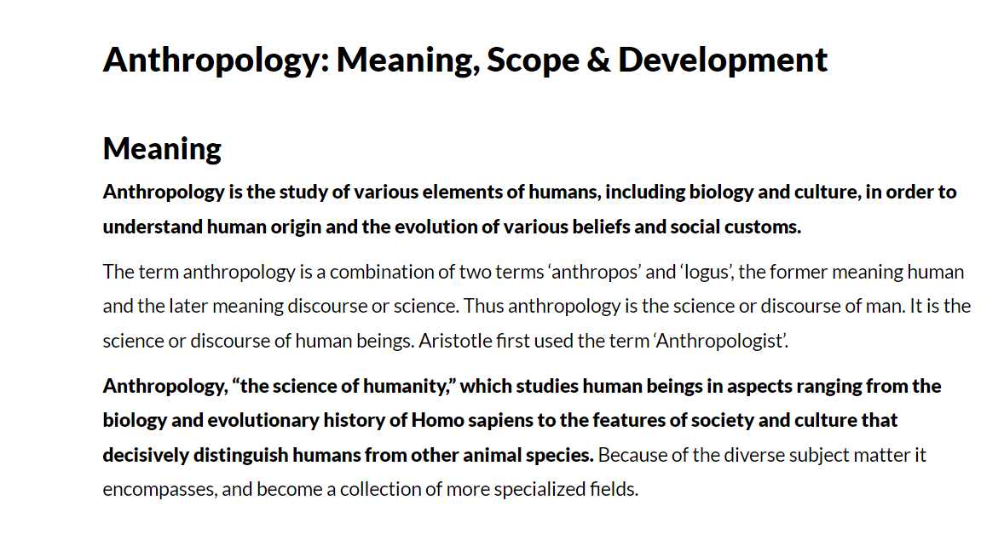

Slide 4
Definition of Anthropology
Oxford dictionary: Anthropology is the study of human societies and cultures and their development.
Encyclopedia Britanica: Anthropology is the study of humans and human behaviour and Societies in the past and present.
Anthropology is the most humanistic of the sciences and the most scientific of the humanities. — Alfred L. Kroeber
Like mathematics or music, anthropology is one of the few genuine vocations. One can discover it in oneself even when one is taught nothing about it. — Claude Lévi-Strauss

Slide 5
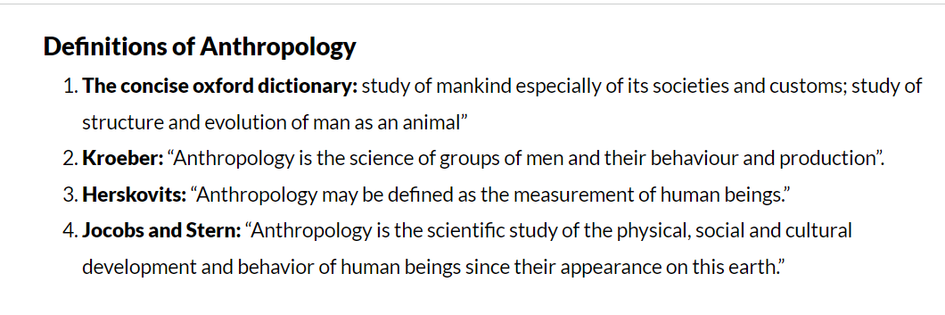
Scope of Anthropology
Anthropology has two main branches-
Physical Anthropology and
Cultural Anthropology.
But in Europe except in England, U.S.A., Australia and other English speaking countries including India, Anthropology means both physical and cultural anthropology and the term ethnology is rarely used for cultural anthropology. Ethnography has been known as merely a descriptive study of human culture.

Slide 6
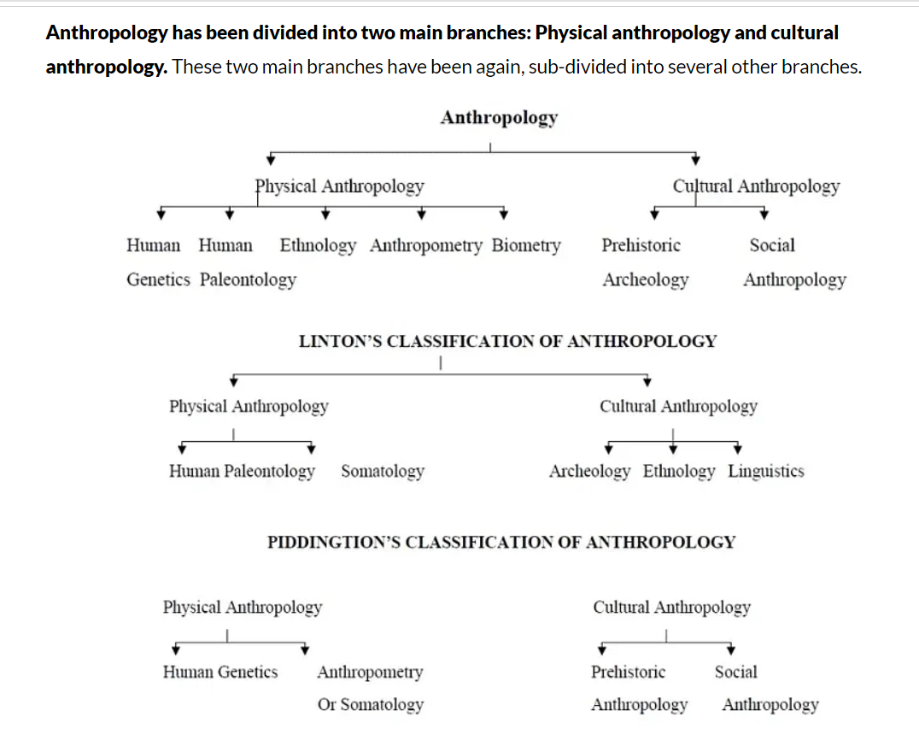

Slide 7

Sub-disciplines of anthropology
Biological Anthropology
Social and Cultural Anthropology
Archeological Anthropology
Linguistic Anthropology

Slide 8
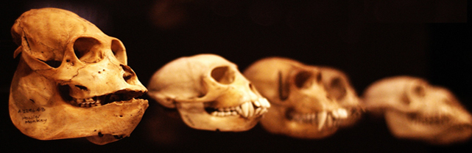
Biological Anthropology
Physical/ biological anthropology is the study of the past and present evolution of the human species and is especially concerned with understanding the causes of present human diversity.
It encompasses fields as disparate as human palaeontology, evolutionary biology, human genetics, comparative anatomy and physiology, primate behaviour, human behavioural ecology, and human biology.
Human biology broadly covers the areas of modern human biological variation, human ecology, nutrition and demography.

Slide 9
Cultural Anthropology
Cultural anthropology relates to the coherence of cultures, including their rules of behaviour, language, material creations and ideas about the world.
Cultural anthropology is concerned with universal variation in culture in the past and present.
The term culture refers to customary ways of thinking and behaving of a particular population or society.

Slide 10
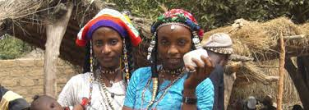
The culture of a social group includes language, religious beliefs, food preferences, music, work habits, gender roles…and many other learned behaviors and ideas that have come to be widely shared or customary among the group
The institution of culture
Material culture
Art and crafts
Kinship
Political organization
Social organizations
Economic organization
Religious system

Slide 11
Social Anthropology
Social anthropology was mainly developed in Britain since the early years of the 20th century. Historically, it has been heavily influenced by intellectual traditions coming from continental Europe, especially from France.
Its tendency is to emphasise social institutions and their interrelationships. It has gone through many theoretical shifts over the past hundred years,
but its emphasis, like that of cultural anthropology, is still on what has been called the ‘deep structure’ of social relations in a particular society

Slide 12

Archeological Anthropology
Archaeological anthropology is the study of past humans and cultures through material remains. It involves the excavation, analysis and interpretation of artifacts, soils, and cultural processes.
Archeology encompasses two major areas: prehistoric archeology which concerns the human past before written records. Historical archeology which deals with the human past in societies that have written documents.

Slide 13
Linguistic Anthropology
Anthropological linguistics is another branch of cultural anthropology.
Linguistics, or the study of languages is one of the older discipline than anthropology, but the early linguistics concentrated on the study of languages that had written for a long time.
Like biological anthropologists linguists study changes that have taken place over times, as well as contemporary variation. The study of how language is used in social contexts is called sociolinguistics.

Slide 14
Linguistic anthropology has three subfields:
Historical linguistics the study of language change over time and how languages are related.
Descriptive linguistic or structural linguistics the study of how contemporary languages differ in terms of their formal structure.
Sociolinguistics the study of the relationships among social variation, social context and linguistic variation, including nonverbal communication

Slide 15
Applied Anthropology
Early in the 19th century, anthropology was a religious philosophy that examined how to view the place of humans in the cosmos.
This began to change by the mid-19th century, and people who were to become the founders of what is called anthropology today began to look at the more earthly nature of humanity. One of these individuals was Lewis Henry Morgan.
Morgan, who was an attorney, began to work with the Iroquois in the 1840s on legal issues involving railroad right of ways.
In India L.P Vidyarthi is known as the founding father of Action and Applied anthropology in South Asia.

Slide 16
Applied Anthropology refers to the application of anthropological data, perspectives, theory, and methods to identify, assess, and solve social problems.
Applied anthropologists may be trained in any or all of the subfields of anthropology such as biological anthropologists, applied archeologists, cultural anthropologists, linguistic anthropologists.
Since anthropologists are experts on human problems and social change, they should make policy affecting people.

Slide 17
Anthropology and other disciplines
Because of its attention to variation and complexity, anthropology is related to almost every academic discipline.
People trained in anthropology contribute to a range of other academic perspectives
Arts: Archaeologists and cultural anthropologists study art for clues about the culture and social organization of a given people. Archaeologists also seek the origins of humans' capacity for creativity and symbolic expression.

Slide 18
Economics: economic anthropologists interested in such conventional topics as production, consumption, and exchange, also examine economic thought in non-market societies, ancient civilizations, and societies in transition from one type of economy to another.
Political sciences: Cultural anthropologists study power too, such as leadership styles in societies of all types, from non-hierarchical ones e.g., hunter-gatherers

Slide 19
Sociology: Sociologists study the organization of people into groups, from smaller ones like the family to larger ones like the corporation. Cultural anthropologists also study social organization, but place greater emphasis on extensive fieldwork
Science and Technology: Biological anthropologists use their training in anatomy, physiology, developmental biology, and neuroscience to investigate how human biology is distinct from other primates and to understand the basis of modern human diversity.

Slide 20
Business Anthropology
Business anthropology is an important subfield of anthropology. Business anthropology apply anthropological theories and practices to the needs of private sector organizations, especially industrial firms.
Area most work on: (1) marketing and consumer behavior, (2) organizational theory and culture, and (3) international business, especially international marketing, intercultural management, and intercultural communication.

Slide 21
Business anthropology is a practice-oriented scholastic field in which anthropologists apply anthropological theories and methods to identify and solve real business problems in everyday life.
According to Business Insider, currently major companies are increasingly seeking business anthropologists.
For example, Google has hired anthropologists to study the meaning of mobile. Intel has hired cultural anthropologists to find out how people living outside the US live their lives. According to the New York Times, Genevieve Bell, as a cultural anthropologist at Intel Labs, runs a team of about 100 researchers. The team studies how consumers interact with electronics and develops new technology experiences for them.

Slide 22

The purpose of anthropology is to make the world safe for human differences. ― Ruth Benedict

Slide 23
Share your ideas of business and see where anthropological knowledge can be applied…

